Slide 1

E-Commerce Product Analysis - Amazon
Amazon – Electronics Products
By Yashwanth K
Batch: DA & DS Nov-24
Date: 11/06/25

Slide 2

Project Overview
This project analyzes product data and applies machine learning strategies.
The objective is to understand market trends and customer preferences.
1
Analyze Product Data
Utilize advanced machine learning strategies.
2
Understand Market Trends
Gain insights into customer preferences.

Slide 3






Web Scraping
Web scraping extracts essential product information.
Key data points include product name, price, and reviews.
Product Name
Price
Rating
Identify unique product identifiers.
Capture current pricing information.
Gather customer rating scores.
Reviews
Brand
Category
Collect user reviews and feedback.
Identify the Brands
Group by Categorical Products
Discount
Discount of Products

Slide 4
Data Cleaning
Data cleaning ensures accuracy and consistency for analysis.
We addressed null values and standardized formats.
Handle Null Values
Clean Price Data
Extract Reviews
Standardize Data
Removed currency symbols (₹).
Parsed numerical review counts.
Formatted all columns consistently.
Price
Rating
Removed commas (,) for numerical conversion.
Ensured consistent format.
Created a separate 'Brand' column for clarity.
Reviews

Slide 5

Data Storage
Data is stored in a MySQL relational database for efficient querying.
This setup ensures reusability for tools like PowerBI, Tableau and Python.
MYSQL Database
Relational Structure
Stored data in the 'Product_db' database.
Enables efficient and complex queries.
Data Reusability
Integrates seamlessly with PowerBI, Tableau and Python.

Slide 6

EDA Analysis
Exploratory Data Analysis (EDA) reveals insights into product data.
We analyzed distributions, top brands, and correlation
Top Brands by Ratings
Price vs. Rating
Examined the relationship between product cost and customer perception.
Identified leading brands based on customer satisfaction.
Distribution Analysis
Correlation Matrix
Determined relationships between key variables.
Reviewed ratings, price, and review counts distributions.

Slide 7
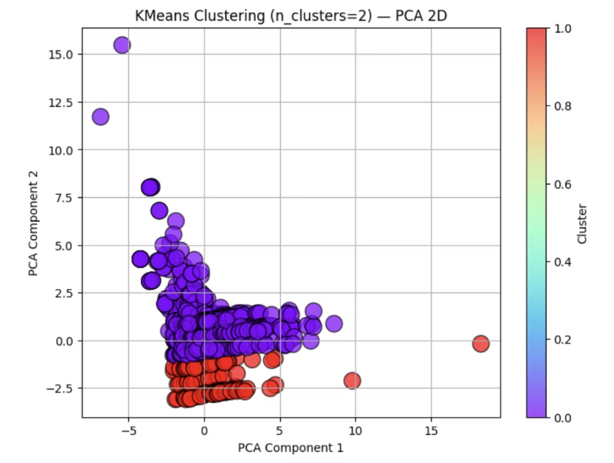
Unsupervised Learning: K-Means Clustering
K-Means clustering categorizes products based on their features.
This helps identify distinct product segments for targeted strategies.

Slide 8


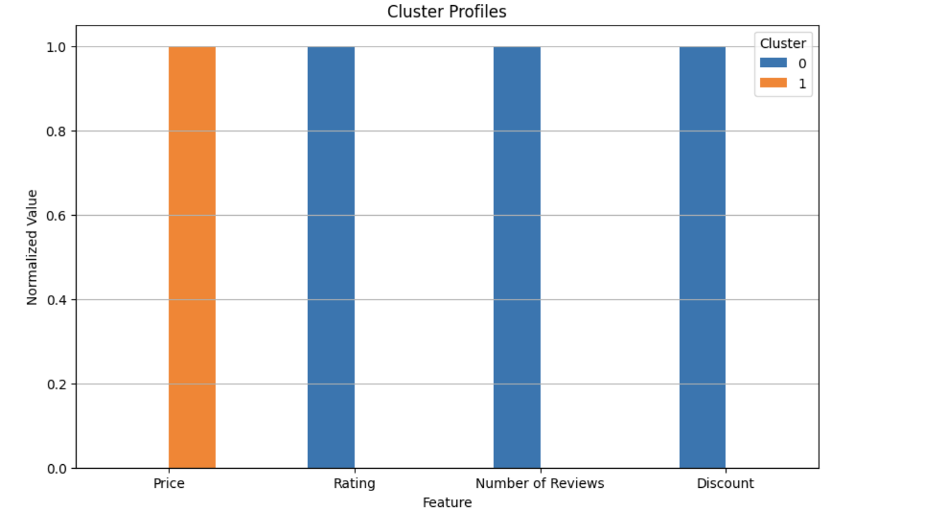


Unsupervised Learning: K-Means Clustering
K-Means clustering categorizes products based on their features.
This helps identify distinct product segments for targeted strategies.
Cluster 0 (Blue)
High rating, very low price: budget products.
Cluster 1 (Orange)
Affordable products.

Slide 9
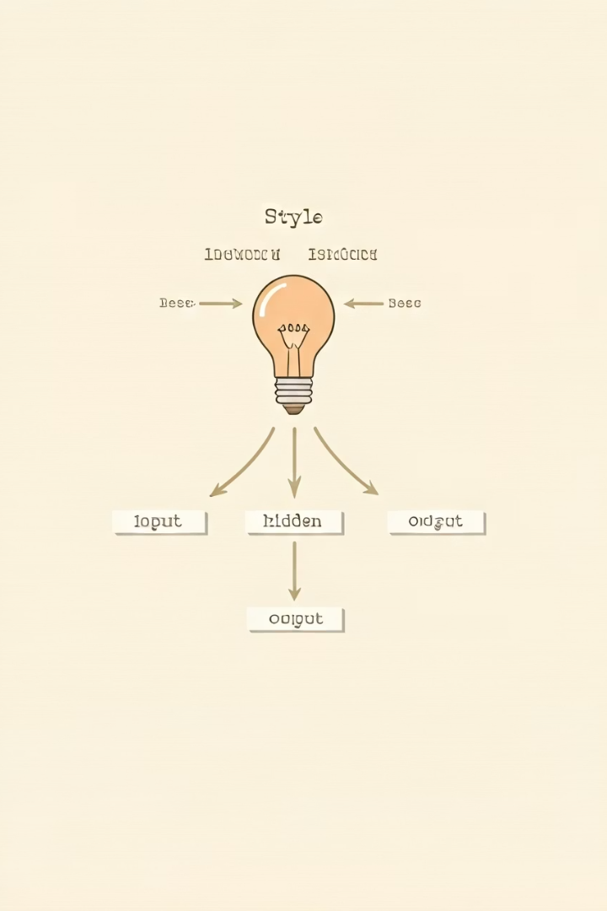



Supervised Learning
We predicted product categories using supervised learning models.
Features were preprocessed with label encoding and standard scaling.
Predicted Category
Model output for product classification.
One Hot Label Encoded
Categorical columns transformed numerically.
Standard Scaler
Features normalized for model training.

Slide 10
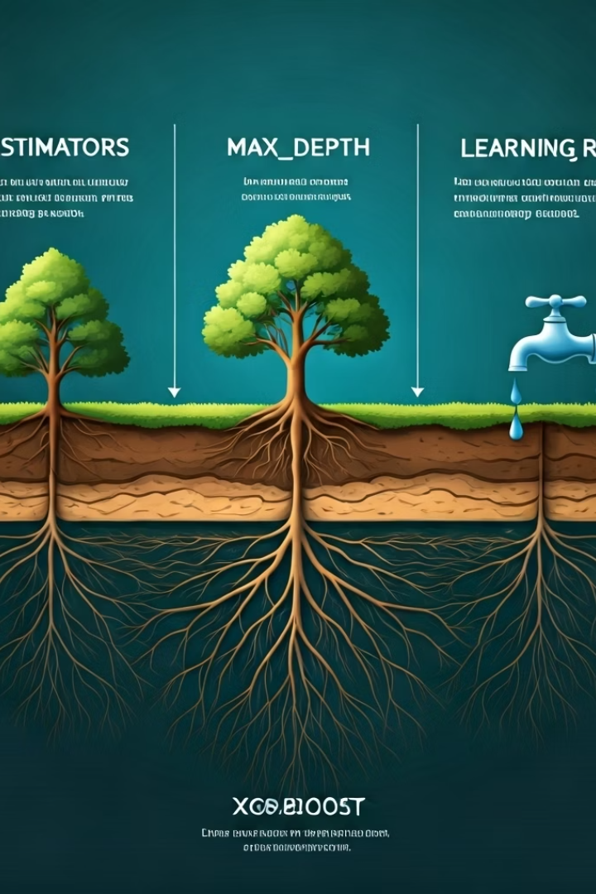
Hyperparameter Tuning
Grid Search CV optimized model performance for XGBoost.
Optimal parameters include n_estimators, max_depth, and learning rate.
n_estimators
500
max_depth
10
learning_rate
0.2
subsample
1.0
colsample_bytree
1.0
Gamma
0.5
Reg_alpha
0.1
Reg_lambda
2.0

Slide 11
Recommdations
Product Segmentation
Segment products by type and customer preferences (budget vs. premium). Use behavior and reviews for targeted marketing.
Targeted Marketing
Launch category-specific campaigns. Promote high-rated products with positive sentiment.
Inventory & Pricing Optimization
Monitor demand to balance stock for fast-moving items. Offer discounts on slow-moving categories.
Quality Control
Identify frequently returned or low-rated products for QA inspection. Focus on brands with consistently low ratings.
Customer Insight Integration
Use review analysis and rating trends for product sourcing and future launches. Highlight top-rated models

Slide 12

Gratitude and Reflection
"The eye of the buyer is sharper than the seller's."

